Slide 1

CISI and CMA, Kuwait
Kevin Moore, Chartered FCSI
Director of Global Business Development
Chartered Institute for Securities and Investment (CISI)

Slide 2
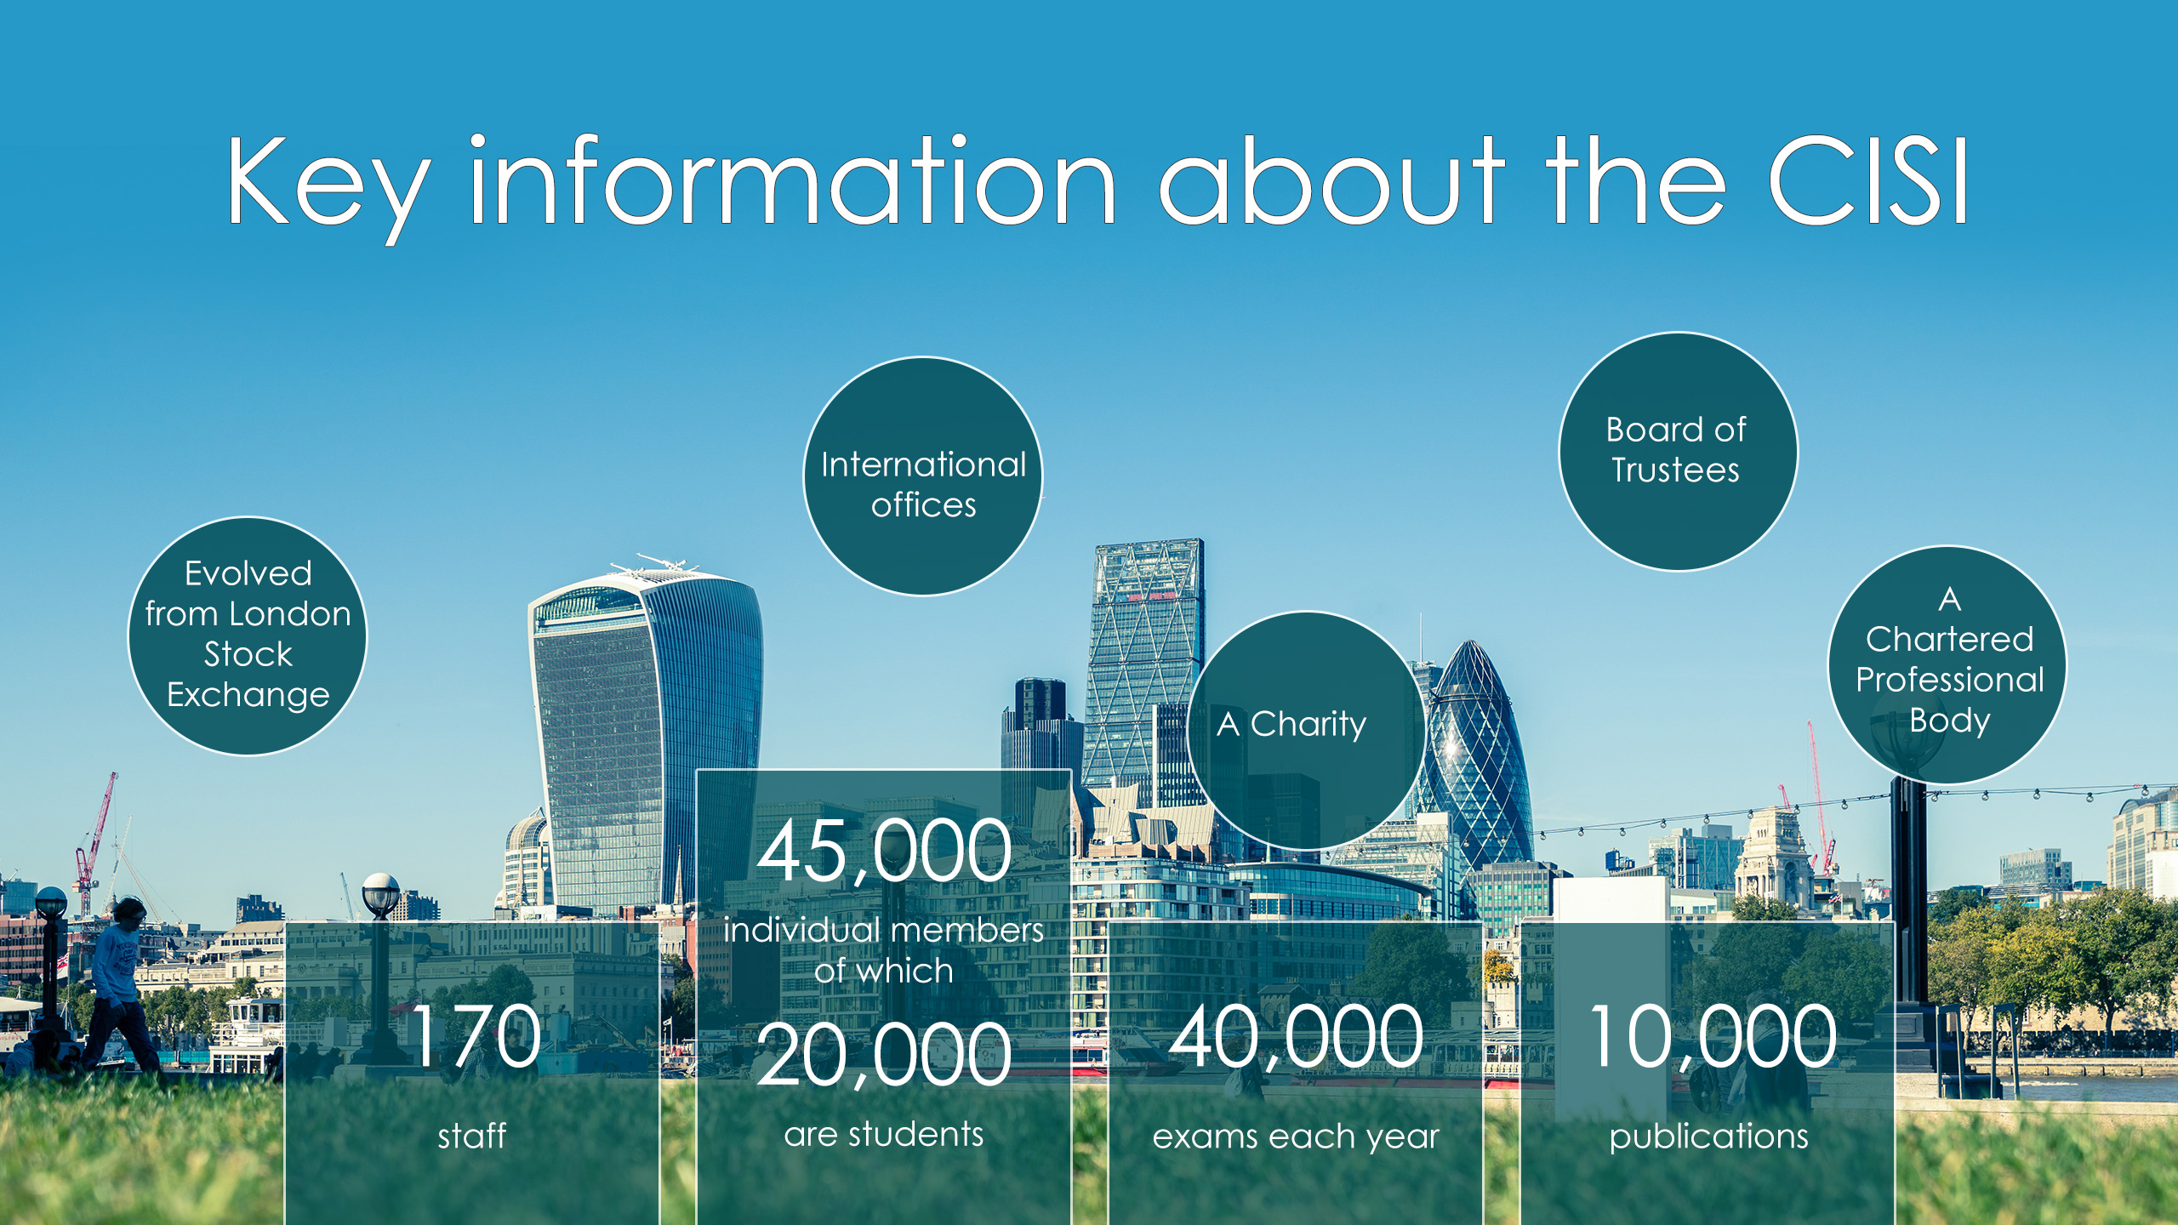

Key information about the CISI
A Charity
A Chartered Professional Body
Evolved from London Stock Exchange 25 years ago
Board of Trustees
170 staff
45,000 individual members…
…of which 20,000 are student members
40,000 exams each year
10,000 publications
International offices

Slide 3
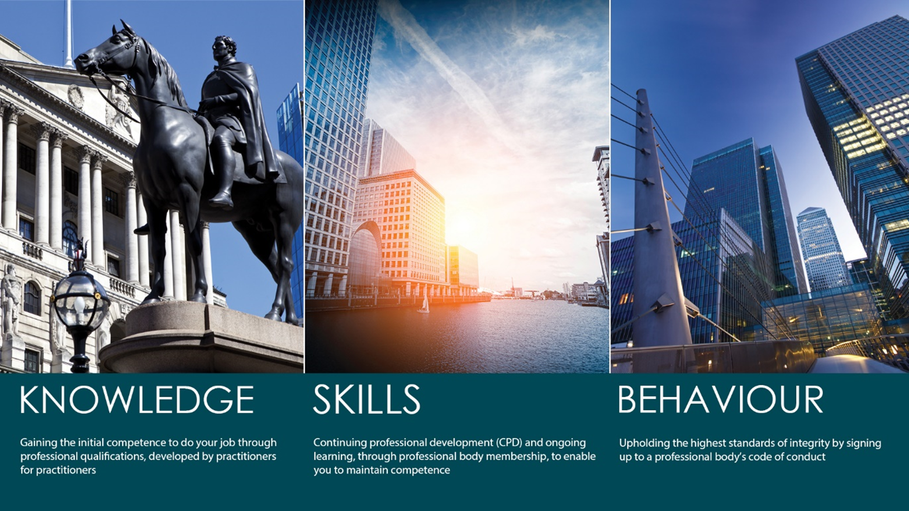
Introducing the CISI
The CISI is a charity which emerged from the London Stock Exchange when it was demutualised over 20 years ago and currently employs 170 professionals, including specialist examination managers and technical operations staff and has over 300 industry volunteers to its credit. The Institute operates globally, with its headquarters in London and regional offices in Mumbai, Dubai, Singapore, Manila, Spain, Columbia, Dublin and Colombo, plus representation in Kenya and Nigeria
In the last twelve months, over 41,000 CISI qualifications have been taken in over 85
countries and over 48,000 people are individual members in 116 countries, with about 20,000 being fully qualified.
The CISI is fully accredited by the UK Regulator, the Financial Conduct Authority (FCA), and is licensed to issue annual Statements of Professional Standing (SPSs) to suitably qualified individuals. The CISI is also regulated by the UK Education Regulator, Ofqual and is fully compliant with all its regulations and requirements.
The CISI’s qualifications are internationally recognised in more than 36 countries and over 92% of the world’s leading banks employ staff who have qualified with the CISI.

Slide 4
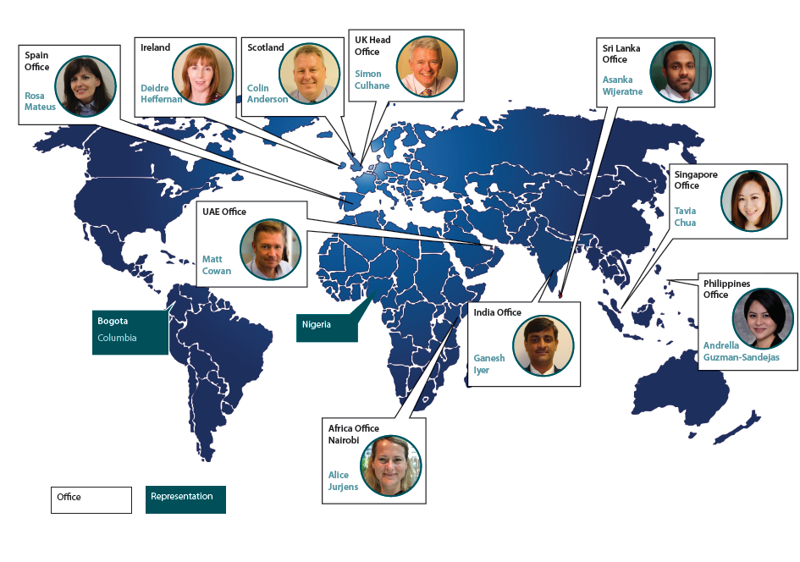
International Representation

Slide 5
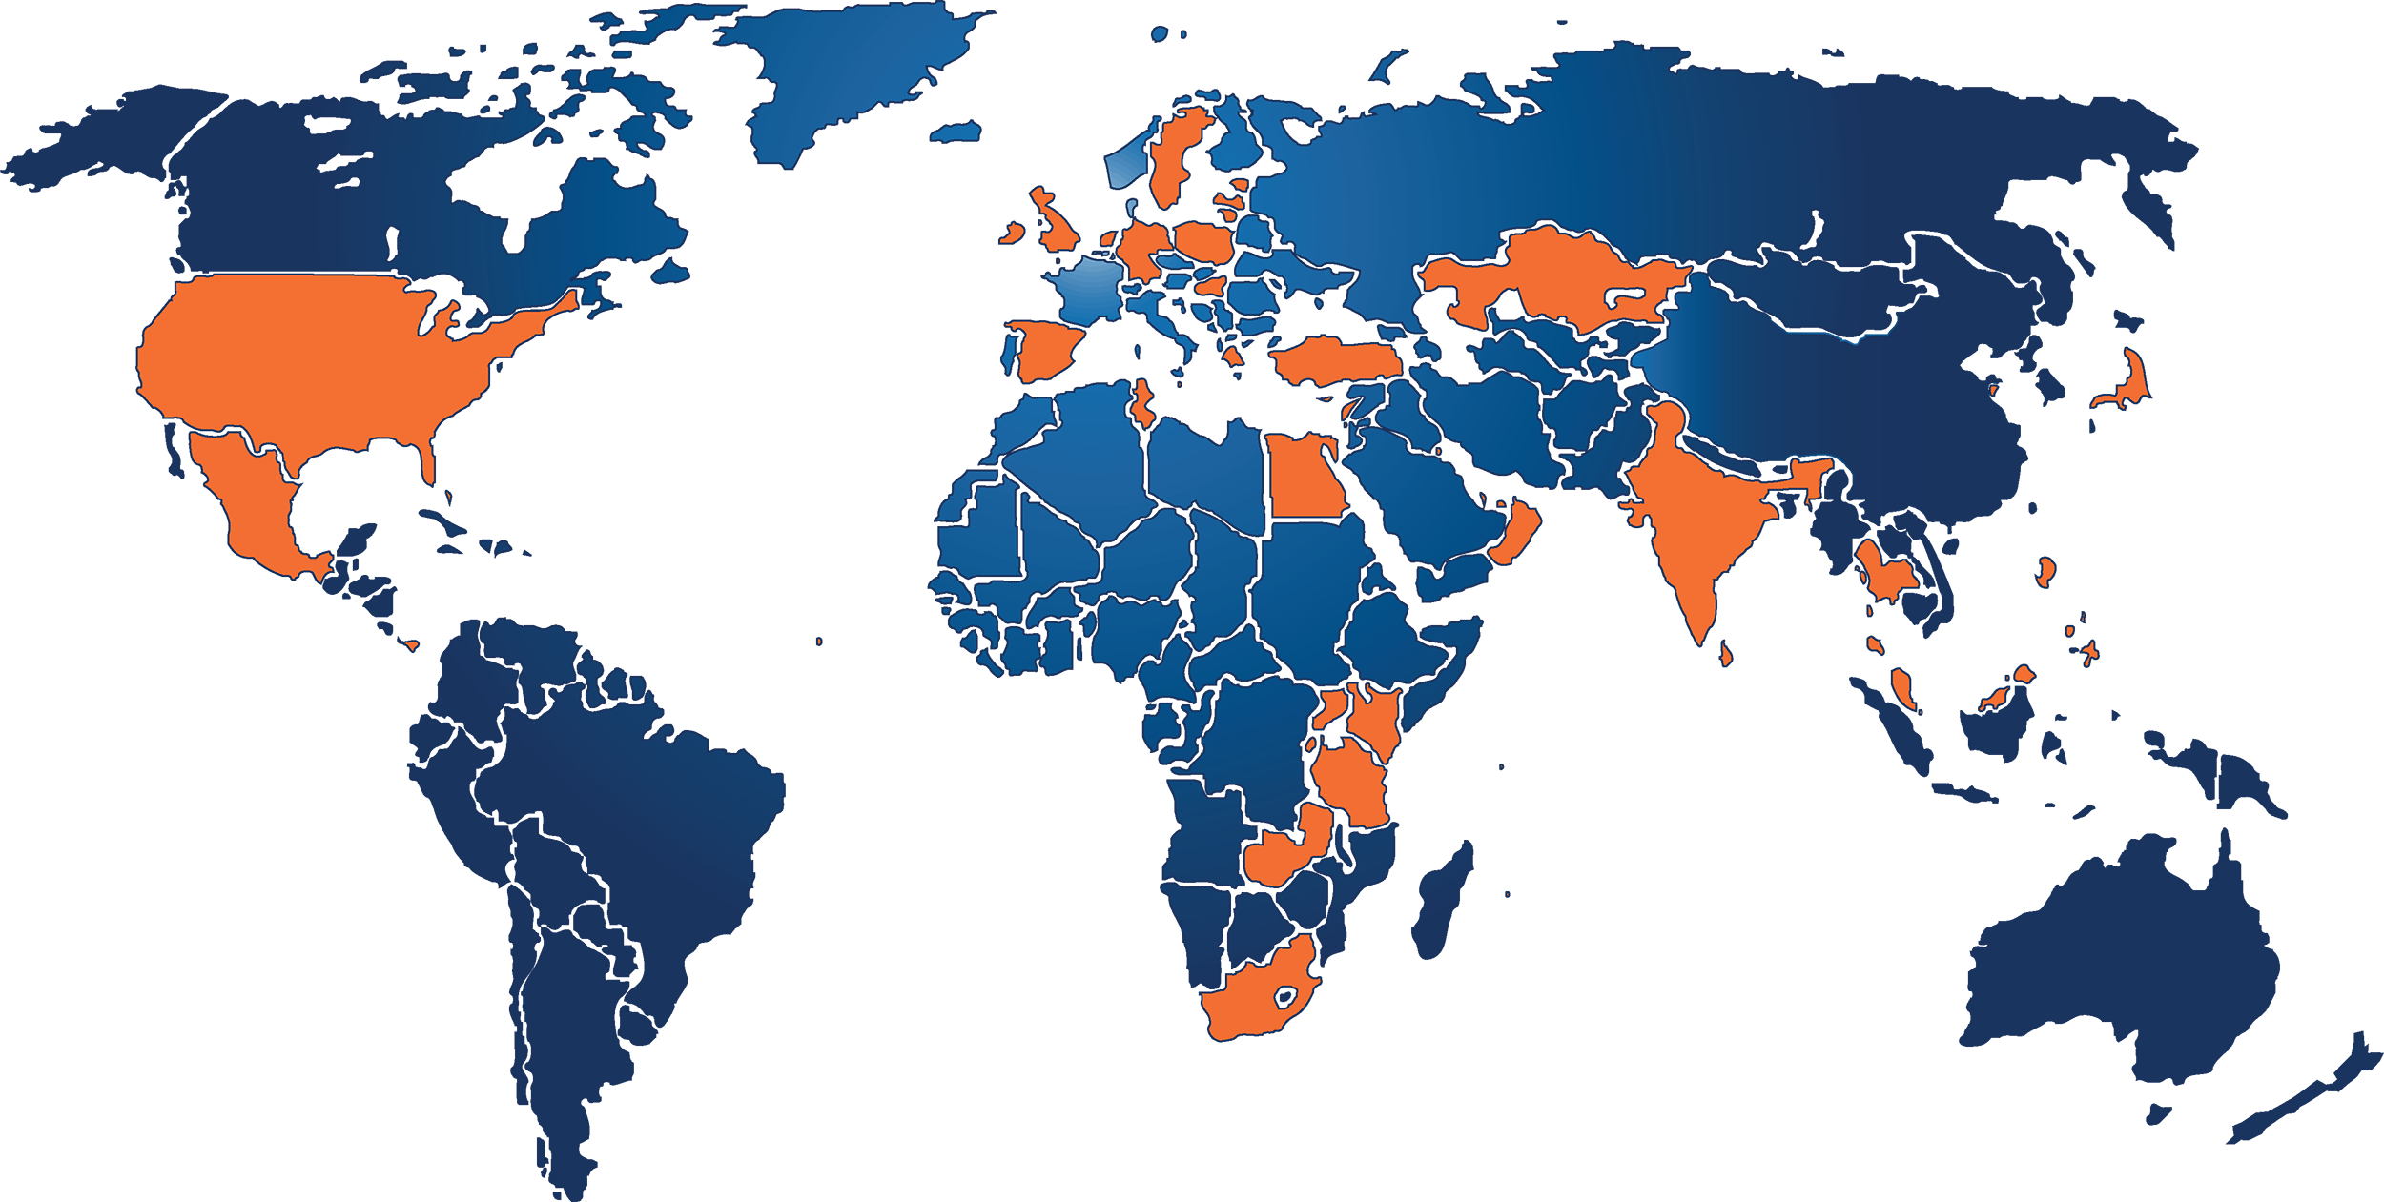
Global Regulatory Connections
Formal links in 47 countries
We have links with all of the top 5 and nearly 50% of top 20 financial centres
Bahamas
Bahrain
China*
Cyprus
Egypt
Estonia
Germany
Gibraltar
Greece
Guernsey
Hong Kong
India
Ireland
Isle of Man
Japan
Jersey
Kazakhstan
Kenya
Kuwait
Labuan
Latvia
Lebanon
Lithuania
Malaysia
Malta
Mauritius
Mexico
Netherlands
Oman
Palestine
Panama
Qatar
Rwanda
Seychelles
Singapore
South Africa
Sri Lanka
Sweden
Tanzania
Tunisia
Turkey
Thailand
UAE
Uganda
UK
USA
Zambia
*Qingdao
Notes:
The Top 20 Financial Centres that we’re missing are in China, Switzerland, Australia, Canada, and Luxembourg (each account for more than 1 Top 20 centre city). China, Luxembourg and Australia are targets for us.

Slide 6








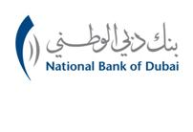
















Who works with CISI and takes our exams?

Slide 7

CISI Professional Qualifications
Created by professionals for professionals
Exam syllabuses produced and reviewed annually by panels of industry practitioners
Qualifications are flexible to suit job requirements – practitioners can add job-related technical units and substitute regulatory exams with those specific to local markets
Questions are practitioner moderated to ensure they are up-to-date and relevant
Benchmark qualifications across the financial services spectrum - operations, retail, wholesale, front, back and middle office.

Slide 8
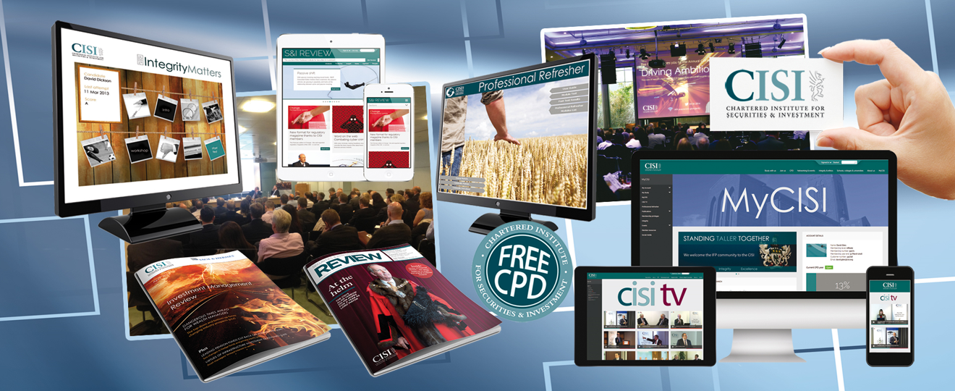
Continuing Professional Development (CPD)

Slide 9

Professional Qualifications in Emerging Markets
Common standards – ensuring harmonisation of standards across regions
Capacity Building and Cooperation through internationally recognised and portable qualifications
Market Development by developing the human capital required for growth
Consumer Protection and Education by ensuring qualified and competent professionals within financial services
Notes:
FTSE Russell officially upgraded Kuwait to a secondary emerging market in Sept ‘17, with effect from Sept ‘18.
Quote from FTSE
“The reclassification of Kuwait is in recognition of the recent market enhancements implemented by the Capital Market Authority of Kuwait and Boursa Kuwait.”

Slide 10

Who Benefits from Professional Certification?
The Regulator and Industry
Professional industry and a common standard
IOSCO minimum entry standards under Principle 29
The Individual
Knowledge, confidence, career opportunities, portability
The Business
Recruitment and retention, benchmarking
Customer Service and quality
The Customer
Confidence in consistent quality of service
Consumer protection
IOSCO: Principle 29
Regulators should provide for minimum entry standards for market intermediaries
A comprehensive assessment of the individual
Demonstration of appropriate knowledge, business conduct…skills…ethical attitude
The entry standards must be consistently applied
Knowledge
Notes:
KM to speak on current activity in the Gulf.
- Qatar
UAE
Bahrain
Oman
Kuwait

Slide 11
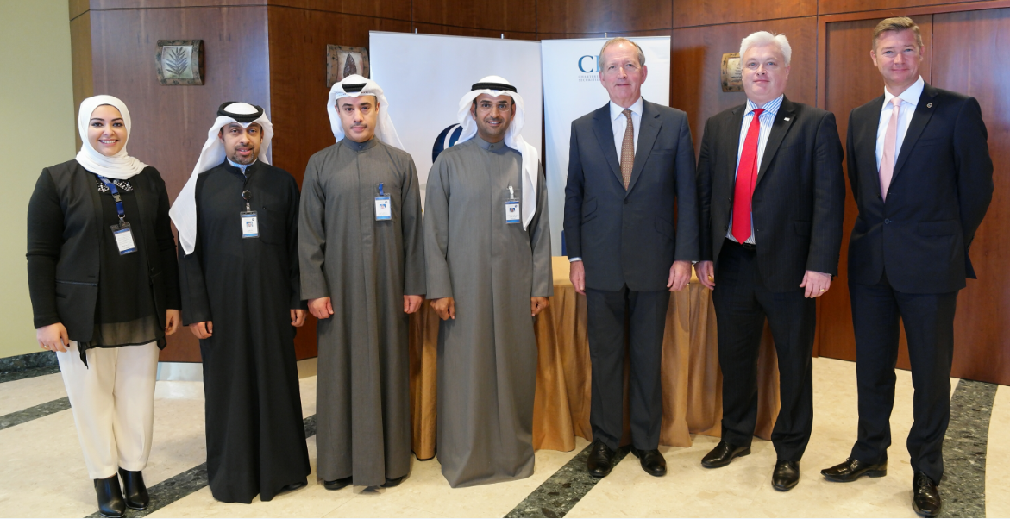
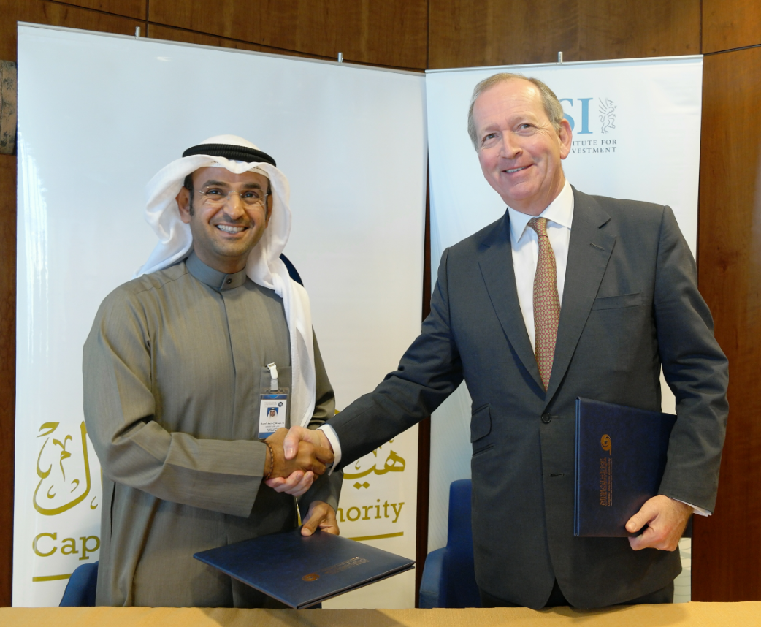

Slide 12

‘My word is my bond’

